Slide 1
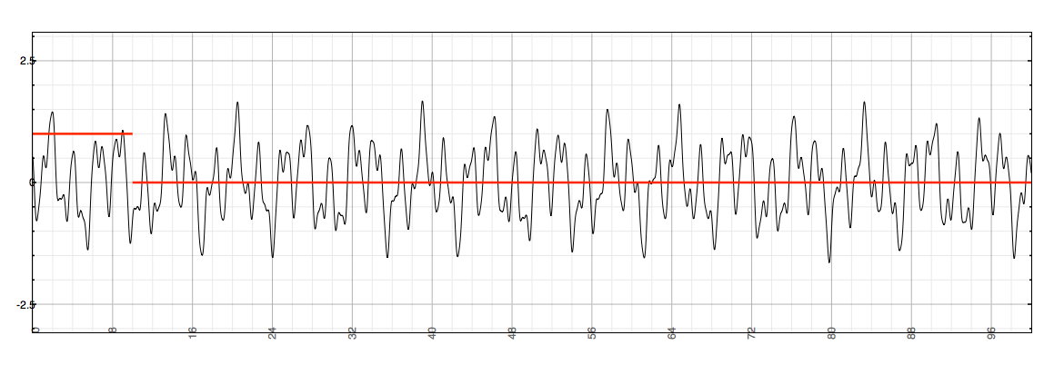
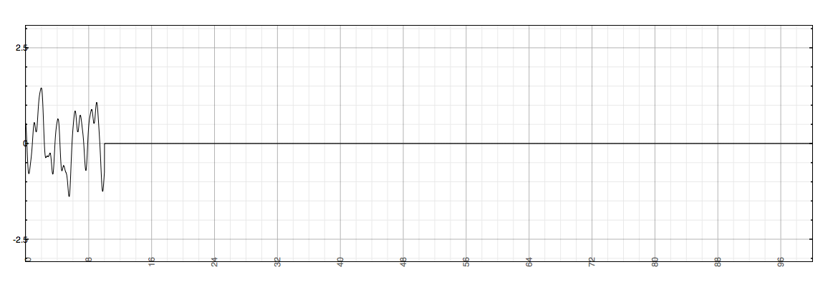
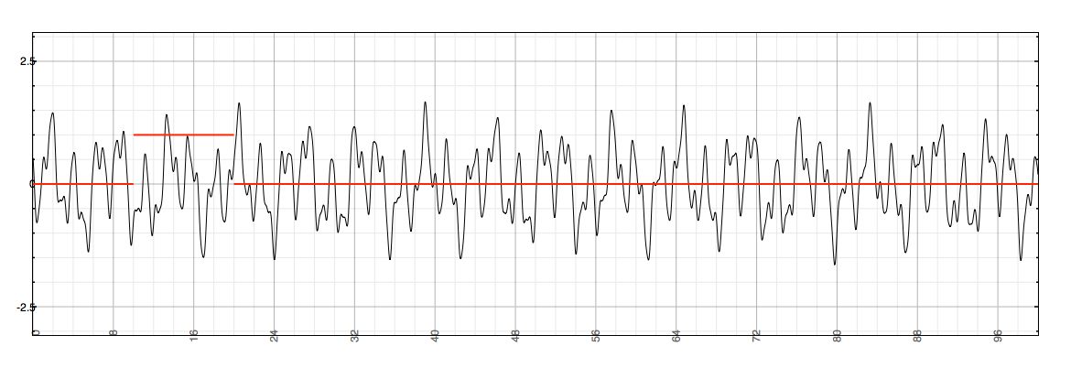
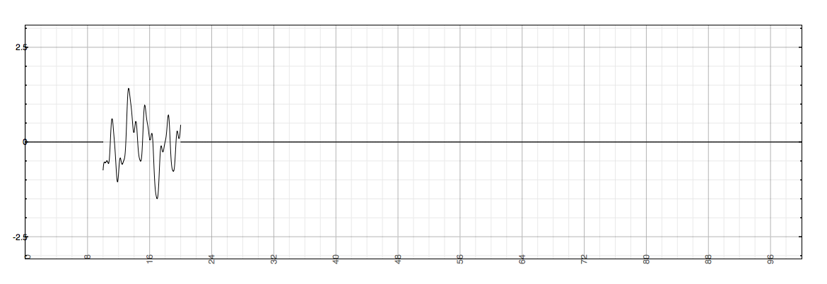
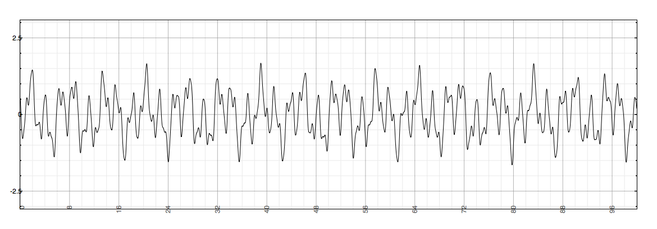
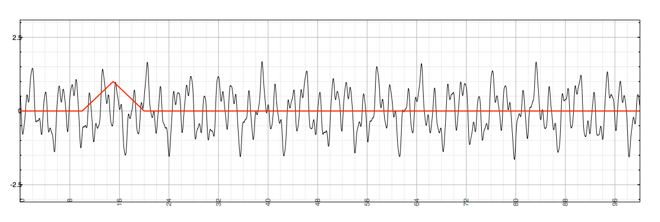
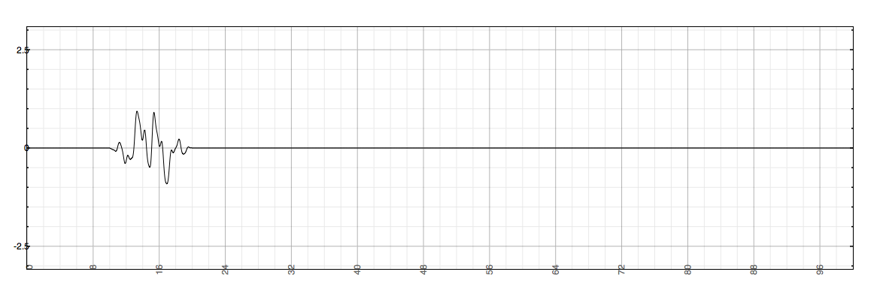
Windowing
Look at short slice of input signal
Want instantaneous snapshot of frequency content
Window signal, then apply DFT
Multiply by nonzero function for fixed length M
Might have shape in nonzero section: rectangular, triangular (Bartlett), Hamming, Blackman...
Can reconstruct windowed signal from DFT length N as long as N ≥ M

Slide 2

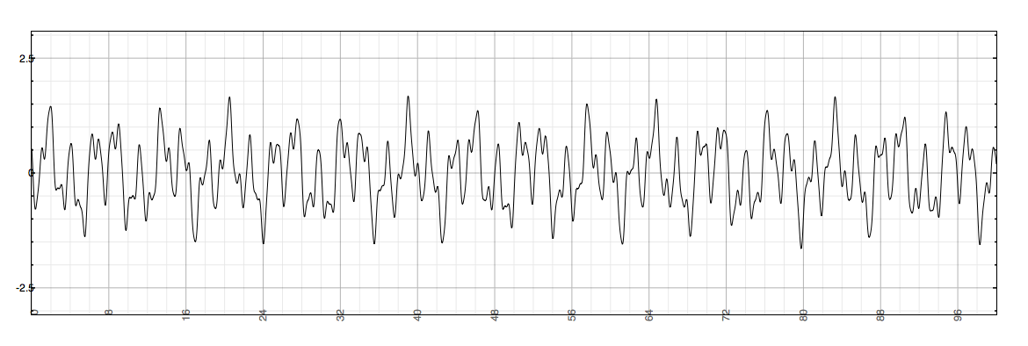
Short-Time Fourier Transform
Short-Time Fourier Transform (STFT) is DTFT of windowed signal
Similarly, can take DFT/FFT for discrete samples of windowed signals
Can break signal into windowed segments
...then (in right circumstances) put it back together

Slide 3
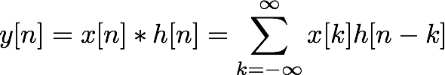

Applications
Many possibilities between DFT and IDFT
Efficient FIR convolution
FIR filter of length N needs N multiplies per sample
Convolution in time = multiplication in frequency
X(z)
H(z)
Y(z)

